Slide 1
Franxx Chat Web
Prepared By :-
Savan Detroja - 92500584067
Aryan Kapadiya - 92500584093
Jevin PArmar - 92500584073

Slide 2
Intoduction to Ptoject
FRANXX is a web-based real-time chat application developed using the MERN stack.
Provides secure communication between registered users.
Supports private and group conversations.
Users can search and connect with other users.
Supports text messages, emojis, images and file sharing.
Provides temporary status updates.
Includes notifications, profiles and settings.
Provides an administrator module for managing users and activities.
Socket.IO enables real-time message delivery without refreshing the page.

Slide 3
Preamble
Communication is an essential part of modern digital life.
Existing applications provide fast and secure communication.
FRANXX is developed as a modern real-time messaging platform.
It is inspired by applications such as WhatsApp, Discord, Telegram and Messenger.
The main aim is to provide a simple, secure and user-friendly communication platform.
Users can communicate through private and group chats.
MongoDB stores user, chat, message and group information.

Slide 4
Module
User Authentication
Dashboard
Private Chat
Group Chat
User Profile
User Search & Connection
Followers & Following
Status
Media & File Sharing
Notification
Settings
Admin Module

Slide 5
Review of literature
Purpose of Study
Analyze existing communication platforms.
Study their major features.
Identify strengths and limitations.
Use the findings as a reference for developing FRANXX.
Existing Systems Studied
WhatsApp
Telegram
Discord
Instagram

Slide 6
TECHNICAL DESCRIPTION
Hardware Requirement
Component | Minimum Requirement
Processor | Intel Core i3 or AMD equivalent
RAM | 4 GB (8 GB Recommended)
Hard Disk | 20 GB Free Space
Internet Connection | Broadband/Wi-Fi
Software Requirement
Software | Requirement
Operating System | Windows 10/11, Linux, or macOS
Frontend | React.js, HTML5, CSS3, JavaScript, Bootstrap/Tailwind CSS
Backend | Node.js, Express.js
Database | MongoDB
Runtime Environment | Node.js (v18 or above)
IDE | Visual Studio Code
API Testing Tool | Postman
Version Control | Git and GitHub
Web Browser | Google Chrome, Microsoft Edge, Mozilla Firefox
Package Manager | npm (Node Package Manager)
Software Requirement

Slide 7
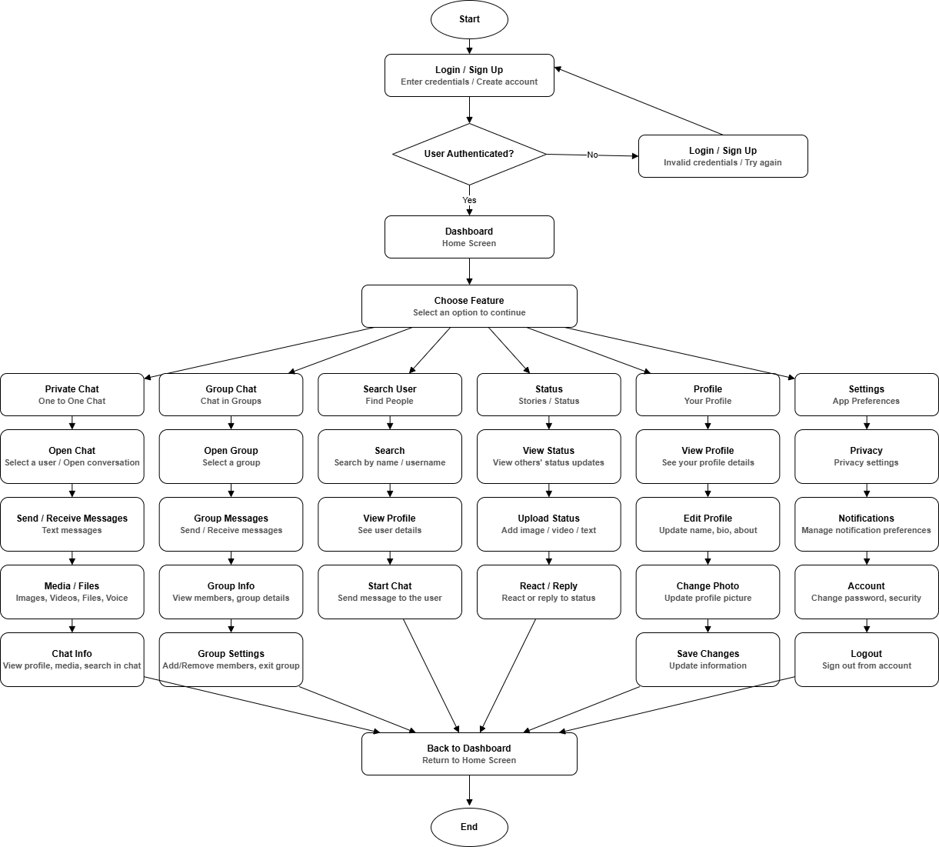
System Design and Development
Flow Chart

Slide 8
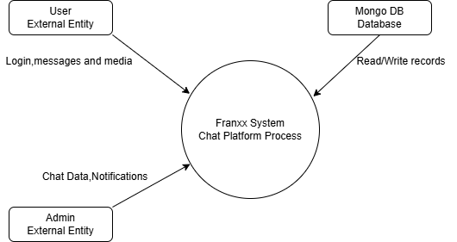
System Design and Development
Level 0 DFD: Context Level Data Flow Diagram

Slide 9
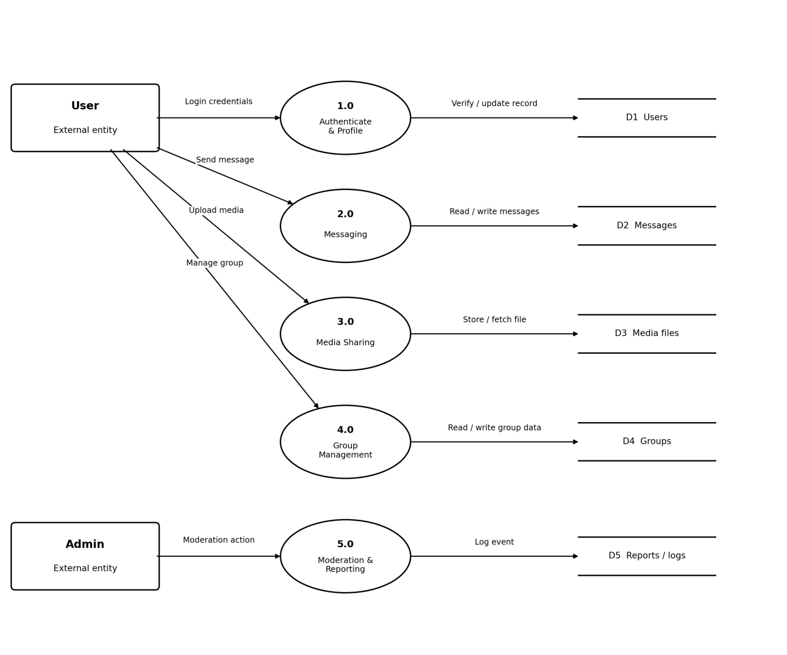
System Design and Development
Level 1 DFD: Franxx System

Slide 10
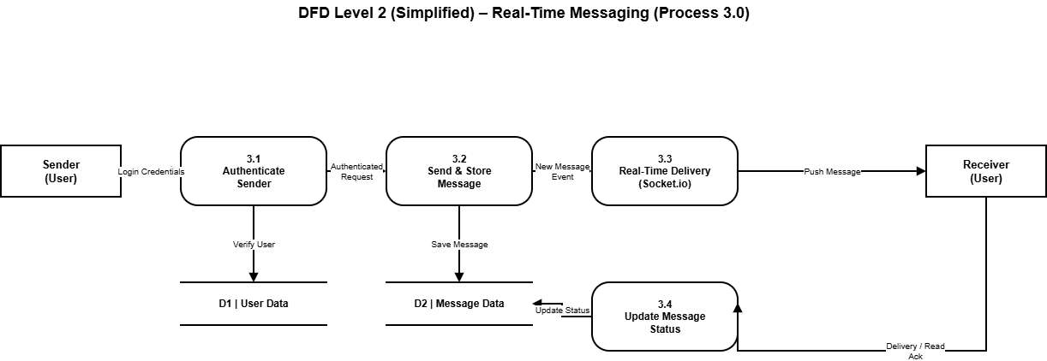
System Design and Development
Level - 2 DFD Messaging

Slide 11
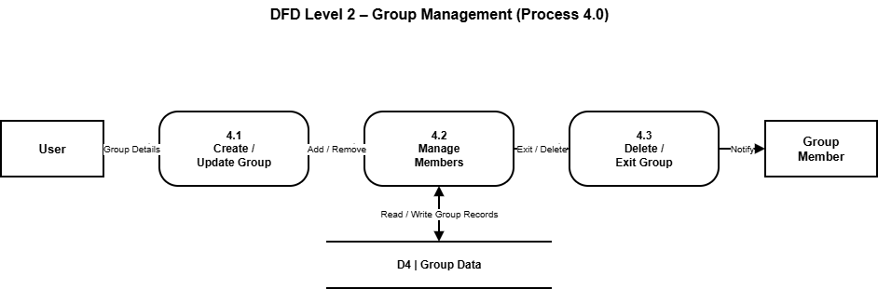
System Design and Development
Level - 2 DFD Group Management

Slide 12
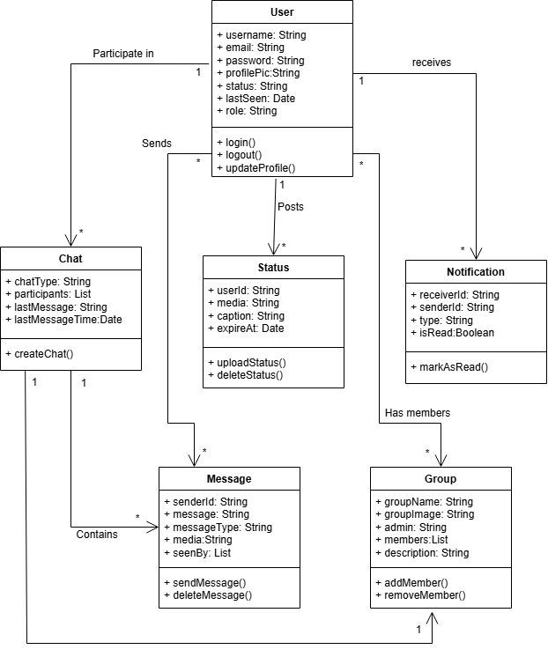
System Design and Development
Class Diagram

Slide 13
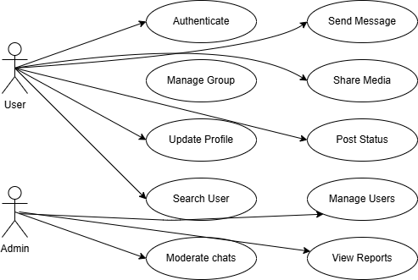
System Design and Development
Use Case Diagram

Slide 14
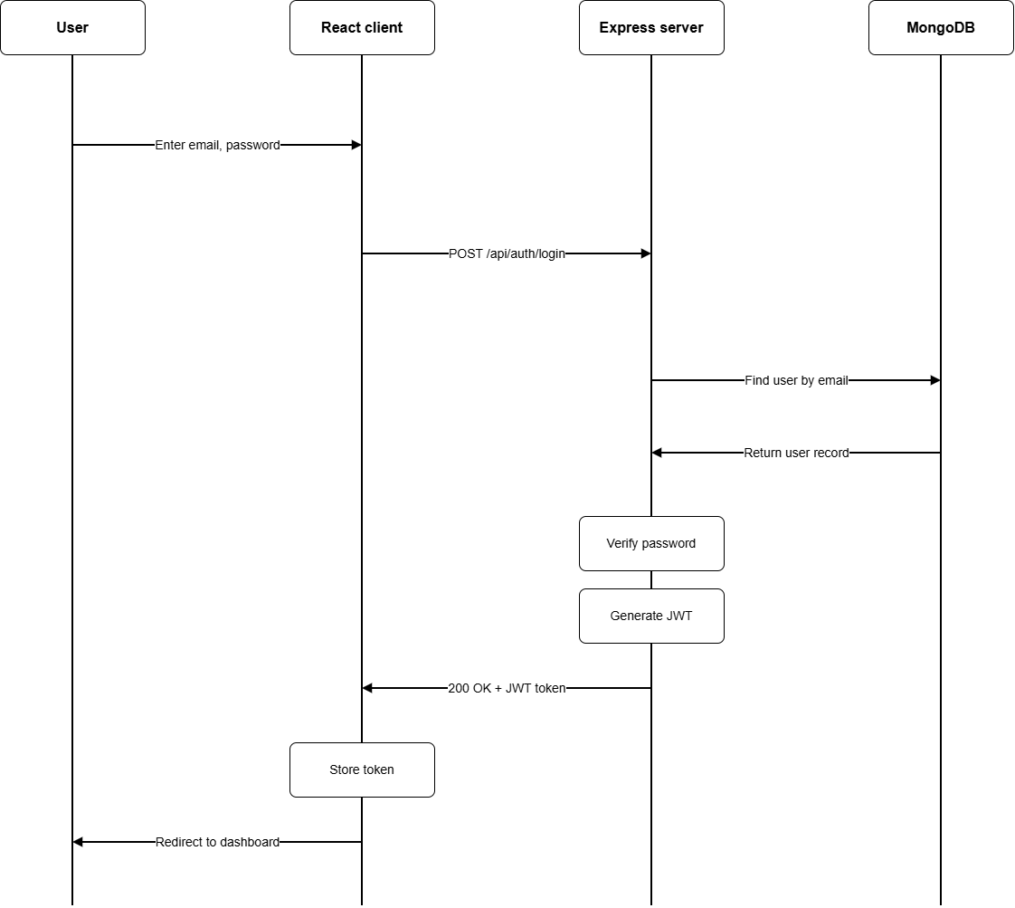
System Design and Development
Sequential Diagram

Slide 15
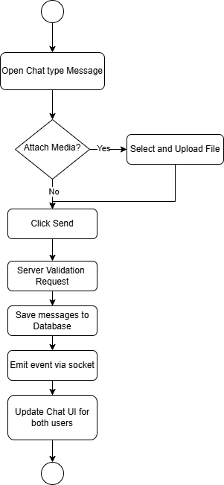
System Design and Development
Activity Diagram

Slide 16
Database Design
Users Table
Field Name | Data Type | Key Constraint | Description
_id | ObjectId | Primary Key | Unique identifier for each user.
fullName | String | Required | User's full name.
username | String | Unique, Required | Unique username.
email | String | Unique, Required | User email address.
password | String | Required | Bcrypt hashed password.
profilePic | String | Optional | Profile image URL.
bio | String | Optional | User biography.
phone | String | Optional | Mobile number.
isOnline | Boolean | Default: false | User online status.
lastSeen | Date | System Generated | Last active timestamp.
createdAt | Date | System Generated | Account creation time.
updatedAt | Date | System Generated | Last update time.

Slide 17
Database Design
Chat Collection
Field Name | Data Type | Key Constraint | Description
_id | ObjectId | Primary Key | Unique chat ID.
chatType | String | Required | Private or Group.
participants | Array(ObjectId) | Required | List of participant IDs.
groupName | String | Optional | Group name.
groupImage | String | Optional | Group profile image.
admins | Array(ObjectId) | Optional | Group admin IDs.
createdBy | ObjectId | Foreign Key | User who created the group.
lastMessage | ObjectId | Foreign Key | Latest message ID.
createdAt | Date | System Generated | Chat creation date.
updatedAt | Date | System Generated | Last update date.

Slide 18
Database Design
Messages Collection
Field Name | Data Type | Key Constraint | Description
_id | ObjectId | Primary Key | Unique message ID.
chatId | ObjectId | Foreign Key | Chat reference.
senderId | ObjectId | Foreign Key | Sender ID.
message | String | Optional | Text message.
messageType | String | Required | Text, Image, Video, Audio, File.
mediaUrl | String | Optional | Uploaded media URL.
replyTo | ObjectId | Optional | Reply message ID.
seenBy | Array(ObjectId) | Optional | Users who have seen the message.
deletedFor | Array(ObjectId) | Optional | Users who deleted the message.
createdAt | Date | System Generated | Message timestamp.
updatedAt | Date | System Generated | Last edit timestamp.

Slide 19
Database Design
Status Collection
Field Name | Data Type | Key Constraint | Description
_id | ObjectId | Primary Key | Unique status ID.
userId | ObjectId | Foreign Key | User who posted status.
mediaUrl | String | Required | Image or video URL.
caption | String | Optional | Status caption.
viewers | Array(ObjectId) | Optional | Users who viewed the status.
expiresAt | Date | Required | Status expiry (24 hours).
createdAt | Date | System Generated | Upload timestamp.

Slide 20
Database Design
Notifications Collection
Field Name | Data Type | Key Constraint | Description
_id | ObjectId | Primary Key | Notification ID.
userId | ObjectId | Foreign Key | Receiver ID.
senderId | ObjectId | Foreign Key | Sender ID.
type | String | Required | Message, Group, Status.
title | String | Required | Notification title.
body | String | Required | Notification content.
isRead | Boolean | Default: false | Read status.
createdAt | Date | System Generated | Notification time.

Slide 21
Database Design
Settings Collection
Field Name | Data Type | Key Constraint | Description
_id | ObjectId | Primary Key | Setting ID.
userId | ObjectId | Foreign Key | User reference.
theme | String | Default: Light | App theme.
language | String | Default: English | Preferred language.
notifications | Boolean | Default: true | Notification preference.
privacy | String | Default: Everyone | Privacy setting.
lastSeenVisibility | String | Default: Everyone | Last seen visibility.
createdAt | Date | System Generated | Created timestamp.
updatedAt | Date | System Generated | Last updated timestamp.

Slide 22
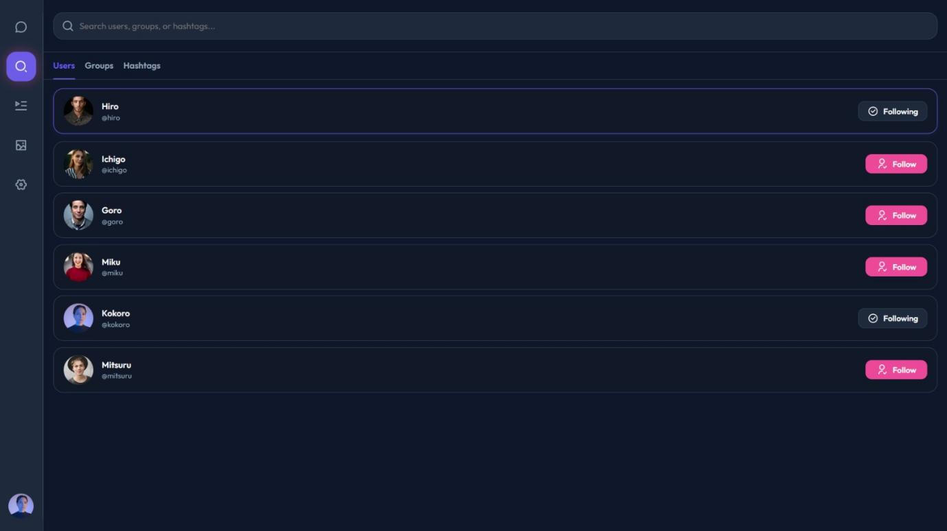
Screen Design
User Search Page

Slide 23
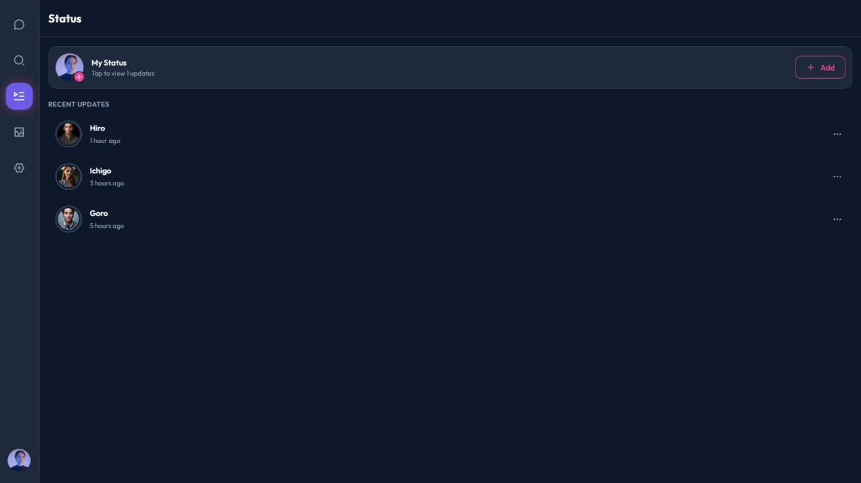
Screen Design
Status

Slide 24
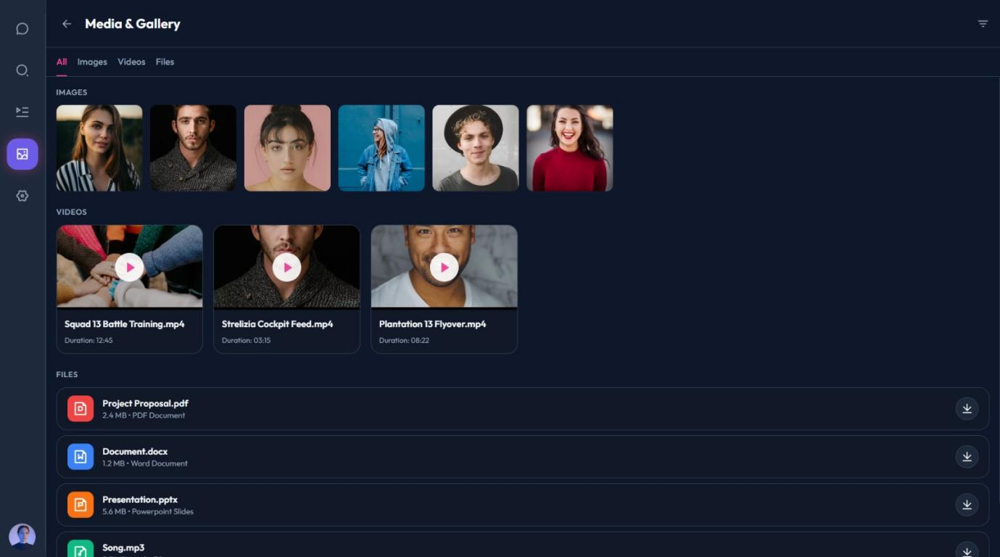
Screen Design
Media and Gallery

Slide 25
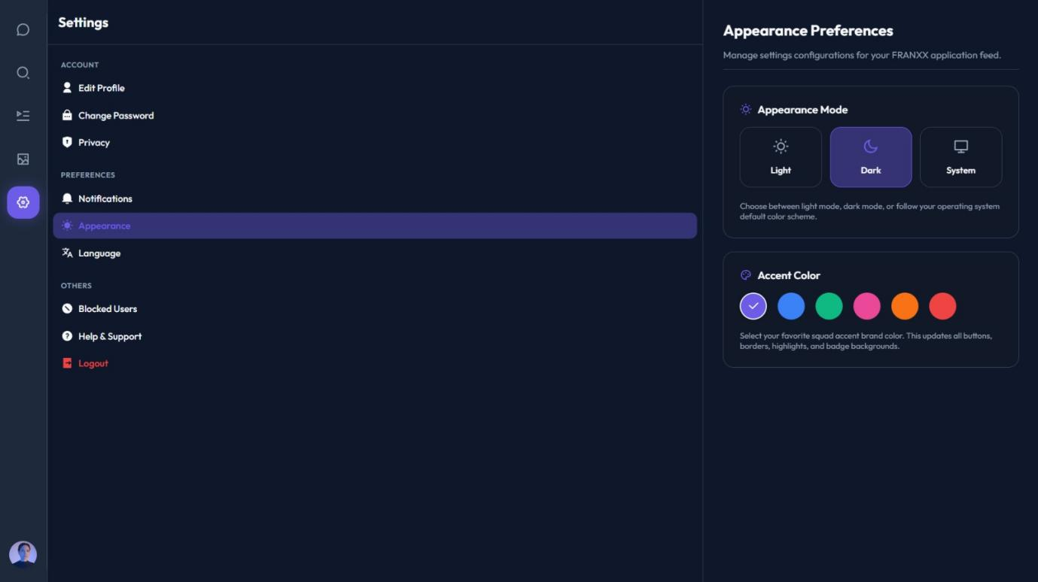
Screen Design
Settings

Slide 26
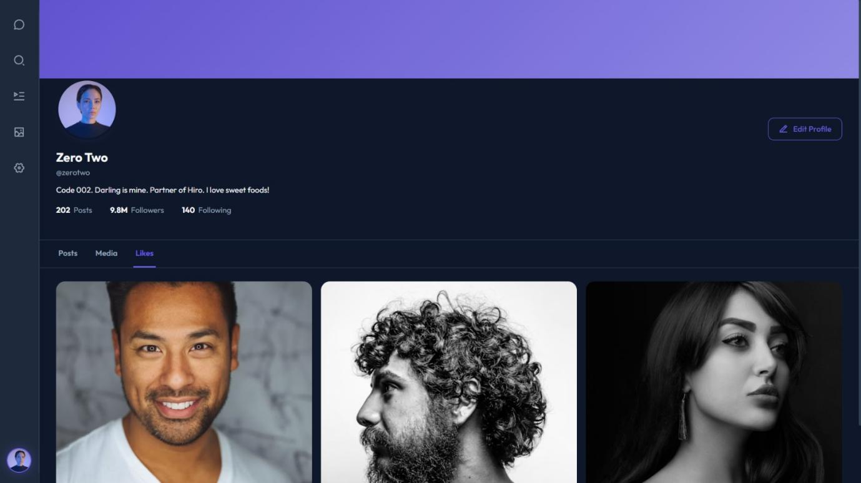
Screen Design
Profile

Slide 27
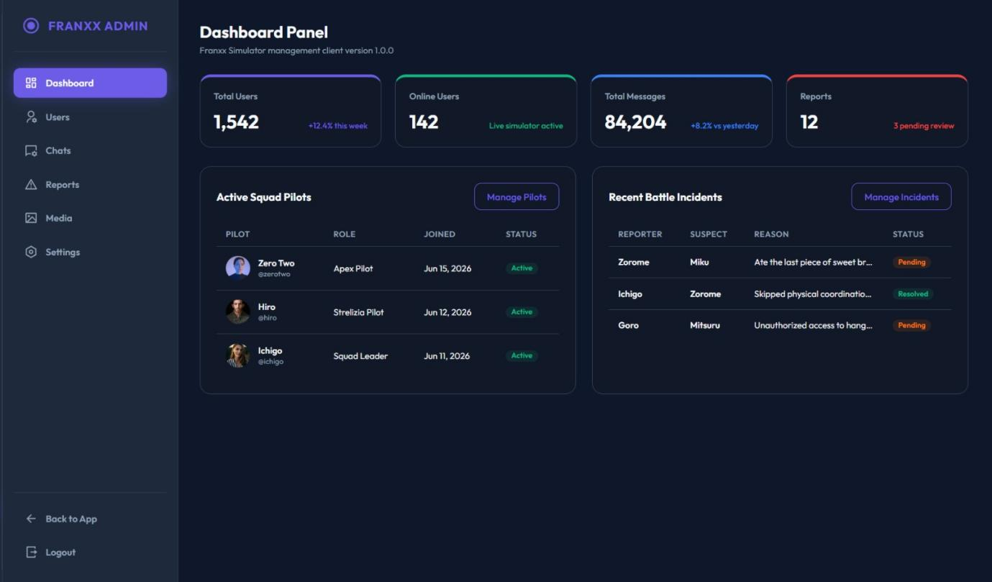
Screen Design
Admin Dashboard

Slide 28
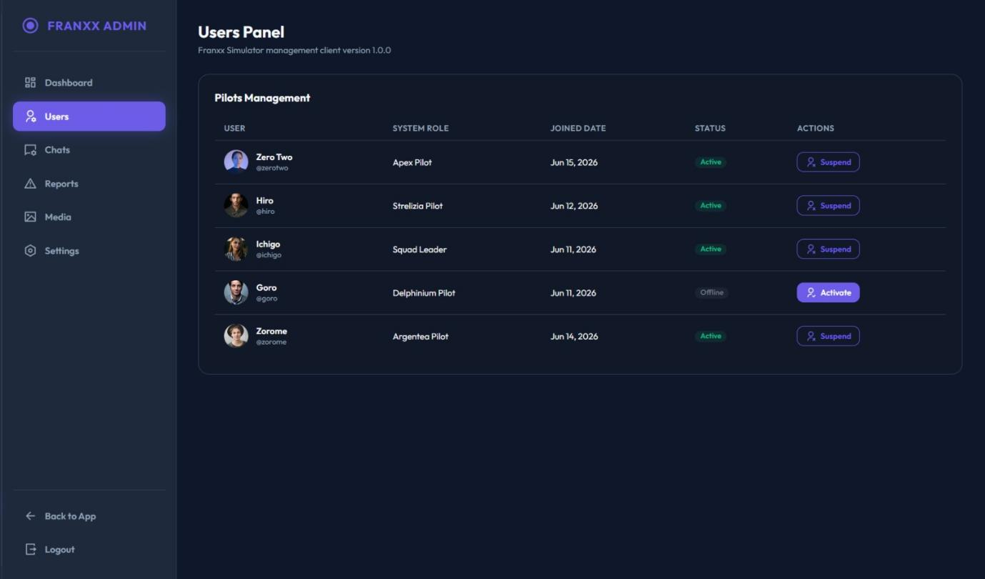
Screen Design
User Panel

Slide 29
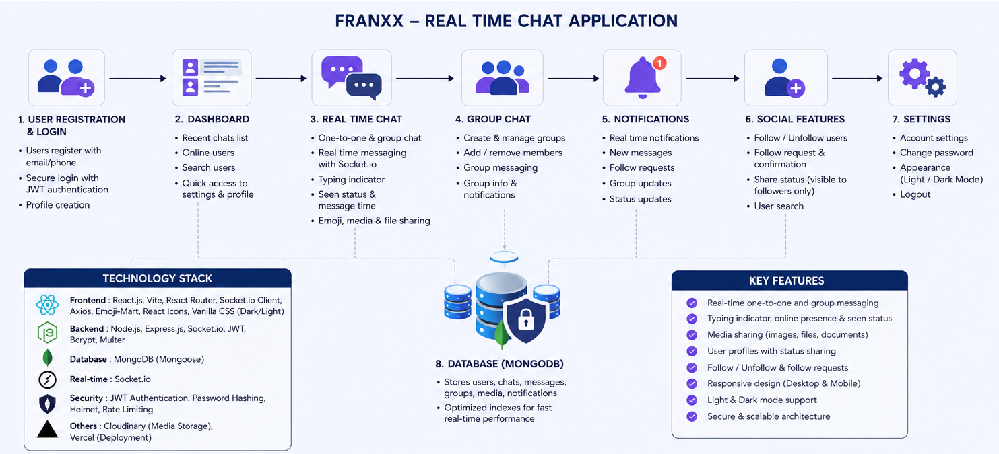
Project overview

Slide 30
Project overview
1. User Registration and Login
Users can create a new account with their details.
Registered users can securely log in to the application.
JWT authentication is used to protect user sessions.
Passwords are securely hashed before storing in the database.
Users can manage their profile information.
2. Dashboard
Displays recent conversations.
Shows online users and their availability.
Users can quickly search for other users.
Provides easy navigation to chats, profile, status, notifications and settings.

Slide 31
Project overview
3. Private Chat
Users can communicate through one-to-one chat.
Messages are delivered in real time using Socket.io.
Typing indicators show when another user is typing.
Online/offline presence and last-seen information are supported.
Users can share text, emojis, images, videos and files.
Message read/seen status is maintained.
4. Group Chat
Users can create group conversations.
Multiple users can communicate in the same chat.
Group members can be added or managed.
Group information and messages are stored in MongoDB.
Group messages are delivered in real time.

Slide 32
Project overview
5. Social Features
Users can search for other users.
Follow and unfollow functionality is available.
Private accounts can receive follow requests.
Follow requests can be accepted or rejected.
Users can block other users when required.
6. Status & Notifications
Users can upload status updates.
Status supports images, videos and text.
Status automatically expires after 24 hours.
The system keeps track of status viewers.
Real-time notifications are provided for follow requests and other activities.

Slide 33
Project overview
7. Settings & Security
Users can edit account/profile settings.
Password change functionality is available.
Users can manage privacy and blocked users.
Light and Dark themes are supported.
Protected routes prevent unauthorized access.

Slide 34
Project overview
8. MongoDB Database
The application stores important information such as:
User accounts and profiles
Followers, following and follow requests
Private and group chats
Messages and media information
Notifications
Status updates and viewers
Search history
Technology Stack:
Frontend: React.js, Vite, React Router, Axios, Vanilla CSS
Backend: Node.js, Express.js
Database: MongoDB with Mongoose
Real-Time: Socket.io
Security: JWT + bcrypt
File Upload: Multer

Slide 35
SYSTEM TESTING
Registration & Login Testing
Test case id | Test case objective | Pre-requisite | Steps | Input data | Expected output | Actual output | Status
Tc_01 | Test user registration | Registration page should be accessible | 1. Open sign up page 2. Enter details 3. Click sign up | Name, username, email, password | User account should be created | Account created successfully | Pass
Tc_02 | Test user login | User should be registered | 1. Open login page 2.Enter email/username 3.Enter password 4. Click login | Valid login details | User should login successfully | User logged in successfully | Pass
Tc_03 | Test invalid login | Login page should be accessible | 1. Enter invalid email 2. Enter incorrect password 3. Click login | Incorrect email/password | Error message should be displayed | Error message displayed | Pass
Tc_04 | Test logout | User should be logged in | 1. Open settings/profile 2. Click logout | Logged-in user | User should logout | User logged out successfully | Pass

Slide 36
SYSTEM TESTING
Private Chat Testing
Test case id | Test case objective | Pre-requisite | Steps | Input data | Expected output | Actual output | Status
Tc_05 | Test private chat | Two users should be connected | 1. Select user 2. Open chat | Selected user | Private chat should open | Chat opened successfully | Pass
Tc_06 | Test send message | Chat should be open | 1. Type message 2. Click send | "hello" | Message should be sent | Message sent successfully | Pass
Tc_07 | Test receive message | Both users should be online | 1. User a sends message 2. Check user b | Text message | Message should appear in real time | Message received successfully | Pass
Tc_08 | Test chat history | Previous messages should exist | 1. Open existing chat | Existing conversation | Previous messages should be displayed | Chat history displayed | Pass
Tc_09 | Test emoji | Chat should be open | 1. Open emoji option 2. Select emoji 3. Send | 😊 | Emoji should be sent | Emoji sent successfully | Pass
Tc_10 | Test message seen status | Message should be sent | 1. Send message 2. Receiver opens chat | Sent message | Seen status should update | Seen status updated | Pass

Slide 37
SYSTEM TESTING
Chat Testing
Test case id | Test case objective | Pre-requisite | Steps | Input data | Expected output | Actual output | Status
Tc_11 | Test group creation | User should be logged in | 1. Open groups 2. Create group 3. Add members | Group name, members | Group should be created | Group created successfully | Pass
Tc_12 | Test group message | Group should exist | 1. Open group 2. Type message 3. Send | "hello group" | All members should receive message | Message received by members | Pass
Tc_13 | Test add member | Group admin required | 1. Open group info 2. Select add member 3. Select user | Registered user | User should be added | Member added successfully | Pass
Tc_14 | Test remove member | Group admin required | 1. Open members 2. Select user 3. Remove | Group member | Member should be removed | Member removed successfully | Pass
Tc_15 | Test group information | Group should exist | 1. Open group 2. Click group header | Existing group | Group details should display | Group details displayed | Pass

Slide 38
SYSTEM TESTING
User Search & Connection Testing
Test case id | Test case objective | Pre-requisite | Steps | Input data | Expected output | Actual output | Status
Tc_16 | Test user search | User should be logged in | 1. Open search 2. Enter username | Username | Matching users should display | Users displayed successfully | Pass
Tc_17 | Test invalid search | Search page should be open | 1. Enter unknown username 2. Search | Invalid username | No user/result message should appear | No result displayed | Pass
Tc_18 | Test user profile | User should appear in search | 1. Search user 2. Click profile | Registered user | User profile should open | Profile opened successfully | Pass
Tc_19 | Test connection request | Another user should exist | 1. Search user 2. Click add | Selected user | Request should be sent | Request sent successfully | Pass
Tc_20 | Test accept request | Request should exist | 1. Open notification 2. Accept request | Pending request | Users should be connected | Connection created successfully | Pass

Slide 39
SYSTEM TESTING
User Profile Testing
Test case id | Test case objective | Pre-requisite | Steps | Input data | Expected output | Actual output | Status
Tc_21 | Test view profile | User should be logged in | 1. Open profile | User account | Profile information should display | Profile displayed successfully | Pass
Tc_22 | Test edit profile | Profile should exist | 1. Click edit 2. Change details 3. Save | Name, about | Profile should update | Profile updated successfully | Pass
Tc_23 | Test profile picture | User should be logged in | 1. Edit profile 2. Select image 3. Save | Image file | Profile picture should update | Picture updated successfully | Pass
Tc_24 | Test other user profile | Another user should exist | 1. Search user 2. Open profile | Selected user | Other user's profile should display | Profile displayed successfully | Pass

Slide 40
SYSTEM TESTING
Status Testing
Test case id | Test case objective | Pre-requisite | Steps | Input data | Expected output | Actual output | Status
Tc_25 | Test text status | User should be logged in | 1. Open status 2. Add text 3. Upload | "good morning" | Text status should upload | Status uploaded successfully | Pass
Tc_26 | Test image status | Status page should be accessible | 1. Select image 2. Upload | Image | Image status should upload | Image uploaded successfully | Pass
Tc_27 | Test status visibility | Users should be connected | 1. User a uploads status 2. User b opens status | User a's status | Connected user should see status | Status displayed successfully | Pass
Tc_28 | Test status privacy | Users should not be connected | 1. Upload status 2. Check from non-follower account | Status | Non-follower should not see status | Status not displayed | Pass
Tc_29 | Test delete status | Status should exist | 1. Open own status 2. Click delete | Existing status | Status should be deleted | Status deleted successfully | Pass

Slide 41
SYSTEM TESTING
Media & File Sharing Testing
Test case id | Test case objective | Pre-requisite | Steps | Input data | Expected output | Actual output | Status
Tc_30 | Test image sharing | Chat should be open | 1. Click attachment 2. Select image 3. Send | Image | Image should be shared | Image shared successfully | Pass
Tc_31 | Test document sharing | Chat should be open | 1. Select document 2. Send | Pdf/document | File should be shared | File shared successfully | Pass
Tc_32 | Test shared media | Shared media should exist | 1. Open chat info 2. Open media | Shared files | Shared media should display | Media displayed successfully | Pass
Tc_33 | Test file download | Shared file should exist | 1. Select file 2. Click download | Shared file | File should download | File downloaded successfully | Pass

Slide 42
SYSTEM TESTING
Notification Testing
Test case id | Test case objective | Pre-requisite | Steps | Input data | Expected output | Actual output | Status
Tc_34 | Test message notification | Two users should exist | 1. User a sends message 2. Check user b | New message | Notification should appear | Notification displayed | Pass
Tc_35 | Test request notification | Users should not be connected | 1. User a sends request 2. Check user b | Connection request | Request notification should appear | Notification displayed | Pass
Tc_36 | Test group notification | User should be group member | 1. Send group activity 2. Check member | Group activity | Group notification should appear | Notification displayed | Pass

Slide 43
SYSTEM TESTING
Settings Testing
Test case id | Test case objective | Pre-requisite | Steps | Input data | Expected output | Actual output | Status
Tc_37 | Test change password | User should be logged in | 1. Open settings 2. Change password 3. Save | Old and new password | Password should update | Password updated successfully | Pass
Tc_38 | Test theme settings | Settings should be accessible | 1. Open theme 2. Select theme | Dark/light | Theme should change | Theme changed successfully | Pass
Tc_39 | Test privacy settings | User should be logged in | 1. Open privacy 2. Change setting 3. Save | Privacy option | Setting should update | Setting updated successfully | Pass

Slide 44
CONCLUSION
FRANXX provides a real-time communication platform.
Users can search and connect with other users.
Supports private and group chats.
Supports media and file sharing.
Provides status updates and profile management.
React.js, Node.js, Express.js, MongoDB and Socket.IO were used.
Most planned modules were successfully implemented and tested.
The system can be enhanced with additional communication and security features.

Slide 45
LEARNING DURING PROJECT WORK
React.js and component-based development.
Node.js and Express.js.
MongoDB database management.
REST API development and integration.
JWT authentication.
Route protection.
Socket.IO and real-time communication.
Git and GitHub.
Debugging and problem solving.

Slide 46
Future Enhancement
Voice Calling
Video Calling
Message Reactions
Reply and Forward Messages
Message Editing
Advanced Privacy
Push Notifications
End-to-End Encryption
Voice Messages
Android and iOS Mobile Application
Cloud Storage
Advanced Admin Monitoring

Slide 47
BIBLIOGRAPHY
Offline References
Text Book :
Software Engineering – A Practitioner’s Approach, Roger S. Pressman, McGraw Hill, 7th Edition.
Unified Modeling Language – User’s Guide, Grady Booch, James Rumbaugh, Ivar Jacobson, Addison – Wesley , 2nd Edition
Online References
[1] MongoDB Inc., “MongoDB Documentation,” [online]. Available:
https://www.mongodb.com/docs/. [Accessed: July 10, 2026].
[2] React, “React Documentation,” [online]. Available:
https://react.dev/. [Accessed: June 20, 2026].
[3] Node.js, “Node.js Documentation,” [online]. Available:
https://nodejs.org/docs/latest/api/. [Accessed: July 25, 2026].

Slide 48
Prepared By :-
Savan Detroja - 92500584067
Aryan Kapadiya - 92500584093
Jevin Parmar - 92500584073
Thank You

